Slide 1
Calculating Displacement

Slide 2
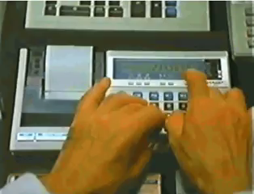
Now that you've learnt about what displacement is, let's learn how to calculate displacement. We will also learn about Pythagoras' Theorem, which is an essential tool for calculating displacements .
By the end of the lesson, you should be able to:
Calculate displacements.
State Pythagoras' Theorem.
Calculate distances using Pythagoras' Theorem.

Slide 3

Calculating Displacement
If an object travels a distance x in a certain direction and then travels a distance y in the same direction, we use the following equation to calculate its displacement (s):
s=x+y

Slide 4

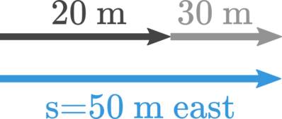
Consider a surfer. He paddles east away from the beach, out into the sea. After reaching 20 m, he stops to rest. Then he starts paddling again for a further 30 m in the same direction.
The surfer's displacement can be found by adding together those two distances, like this:
s = 20 m+30 m=50 m east
Remember, s is the mathematical symbol for displacement.

Slide 5
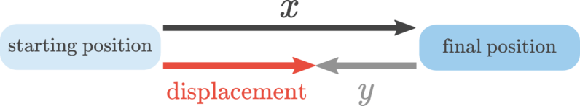
If an object travels a distance x in a certain direction and then travels distance y in the opposite direction, we use the following formula to calculate displacement:
s=x−y

Slide 6

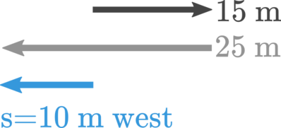
For this example, let's have a look at another surfer. Suppose he paddles 15 m to the east, then catches a wave that carries him 25 m to the west. To find his displacement, we need to subtract these two distances because they are in opposite directions.
s=25 m−15 m=10 m west

Slide 7


Slide 8
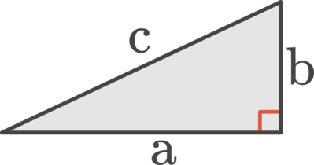
Pythagoras' Theorem is a mathematical expression that relates the three side lengths of a right-angled triangle.
Consider this triangle. It has a right angle shown by the red square.
The side opposite the right angle, c, is the longest side of the triangle. a and b are simply the other two sides.

Slide 9

Pythagoras' Theorem is defined by the following equation:
c²=a²+b²
We'll look at a written example of how it's used, but first, let's think about why we need to use this equation at all. Imagine your neighbour's pet perentie has broken loose and is wandering around the block. (Scary thought, right?)

Slide 10
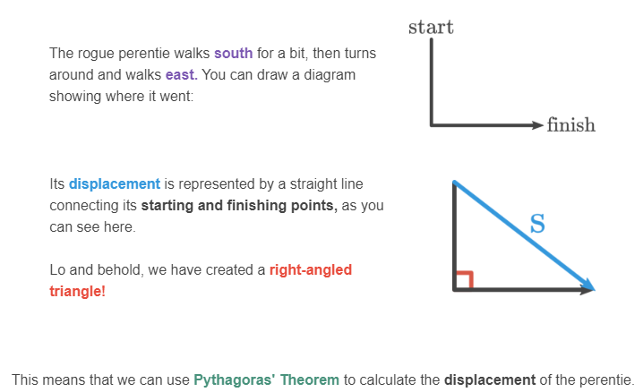
The wandering perentie:

Slide 11
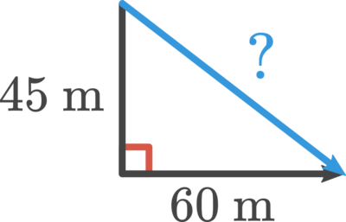

Now let's put some numbers on that triangle and find the perentie's displacement. Say it moved 45 m south, then smelled a tasty BBQ down the road and walked 60 m east toward it.
In the equation for Pythagoras' Theorem, we can say a=45 m and b=60 m.

Slide 12
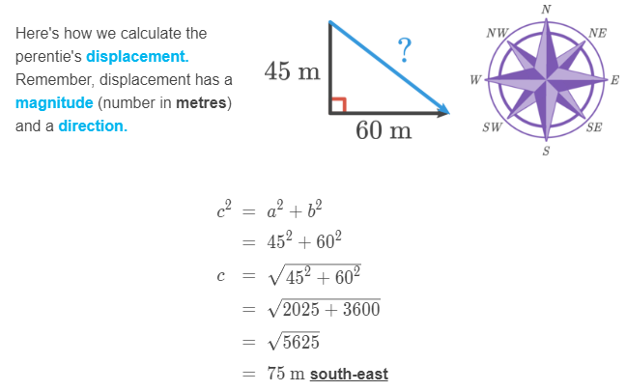

Slide 13

One more thing.
In this example, the answer came out as a whole number, but when you use Pythagoras' Theorem you often get answers that are recurring decimals. That means they have an infinite number of digits!
When you get an answer like this, it must be rounded so the computer can mark it. In the exercises that follow, our answers will be rounded to 2 significant figures. You can leave them more accurate if you want to.

